Slide 1
Project Overview: Analysis of New York City Neighborhoods for Aspiring Businesses
By Anish Pandit

Slide 2
Business Problem
A small, family-owned coffee shop business is planning its move to New York City. Where in New York City will this business be able to capture the attention of audiences, with limited competition?

Slide 3
Scope
The premise of this Capstone Project is to leverage the Foursquare API location data for the city of New York, to analyze the business composition of the city’s major neighborhoods. The boroughs in consideration for the scope of this project include Manhattan, Brooklyn, Queens, and the Bronx. Using the clustering method analysis, the optimal location for an aspiring business can be determined, based upon the factors of competition and potential market.

Slide 4
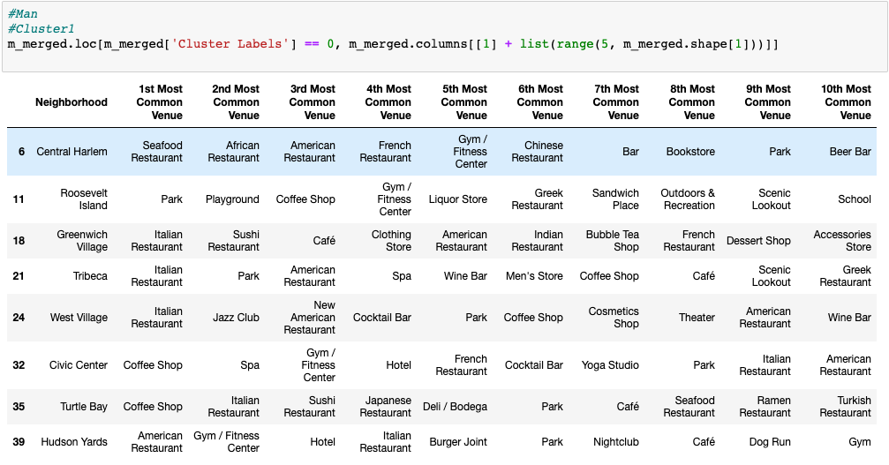
Data Analysis: KMEans Clustering
Manhattan – Cluster 1

Slide 5
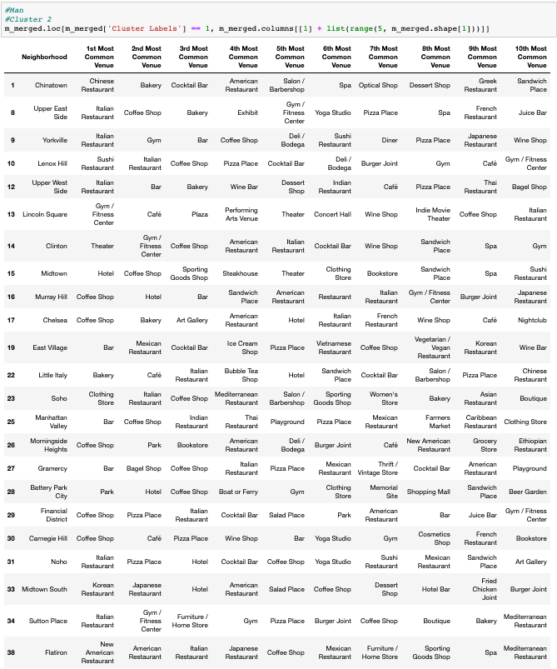
Data Analysis: KMEans Clustering
Manhattan – Cluster 2

Slide 6
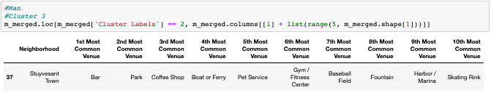
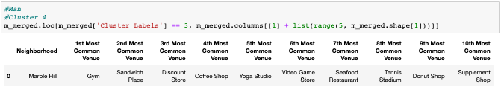
Data Analysis: KMEans Clustering
Manhattan – Cluster 3 & 4

Slide 7
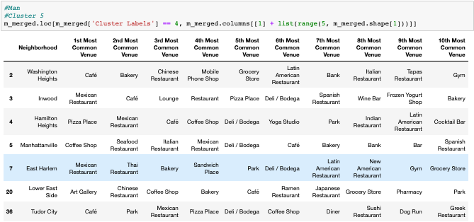
Data Analysis: KMEans Clustering
Manhattan – Cluster 5

Slide 8
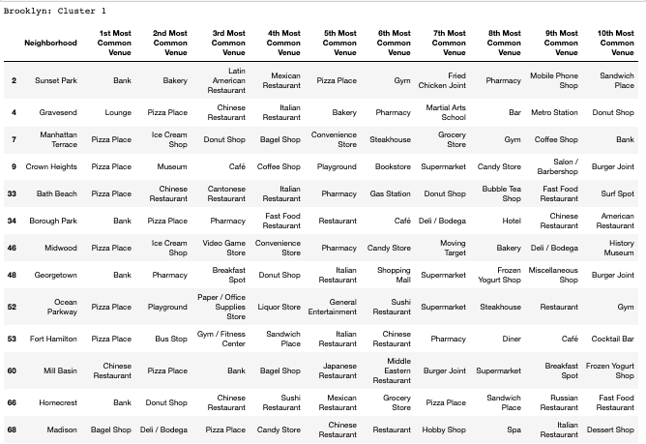
Data Analysis: KMEans Clustering
Brooklyn – Cluster 1

Slide 9
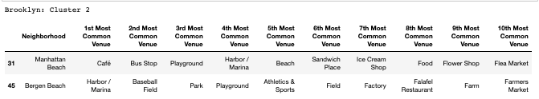

Data Analysis: KMEans Clustering
Brooklyn – Cluster 2 & 3

Slide 10
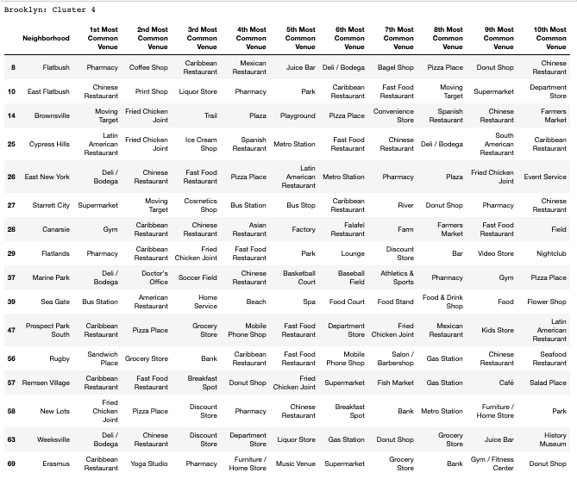
Data Analysis: KMEans Clustering
Brooklyn – Cluster 4

Slide 11
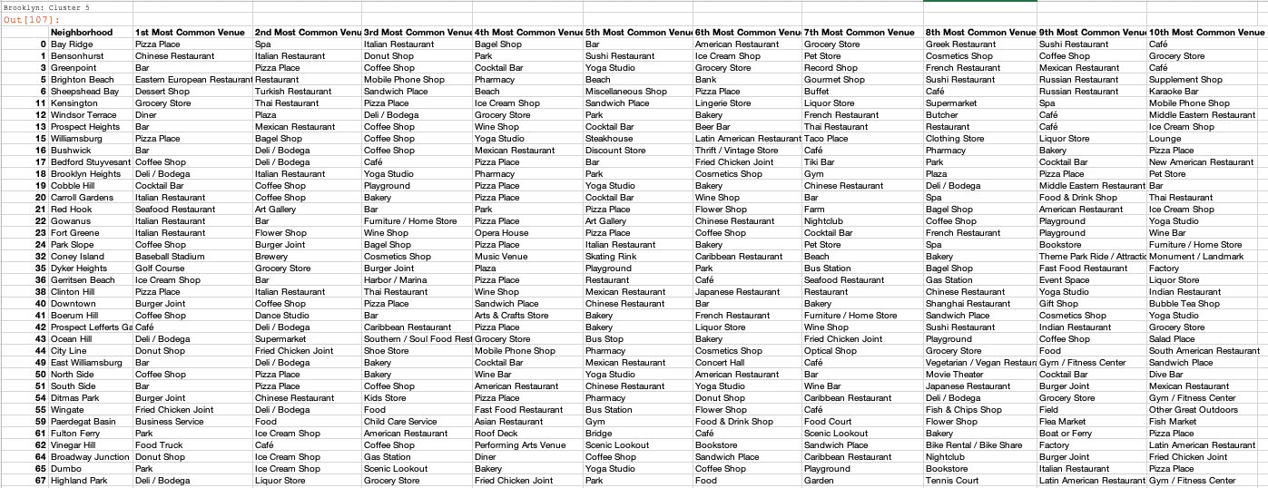
Data Analysis: KMEans Clustering
Brooklyn – Cluster 5

Slide 12
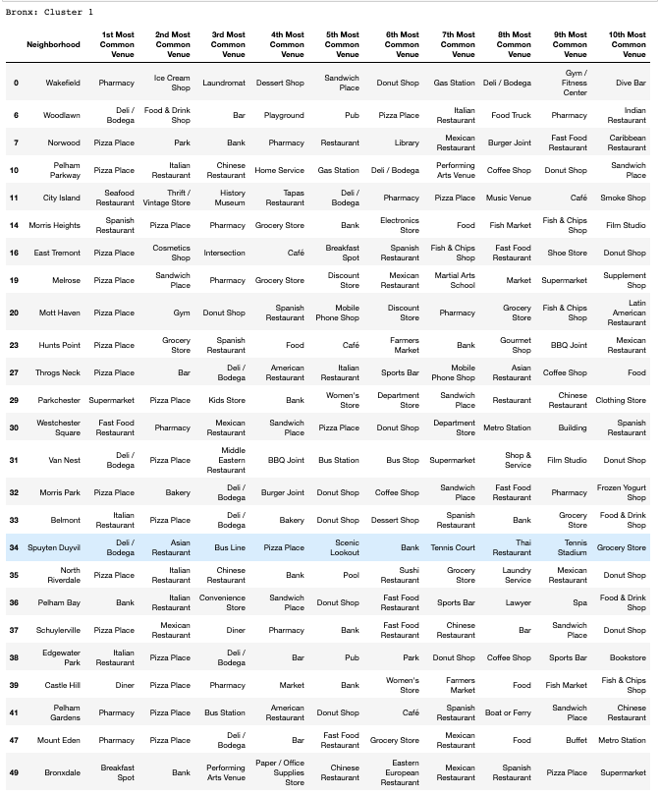
Data Analysis: KMEans Clustering
Bronx – Cluster 1

Slide 13
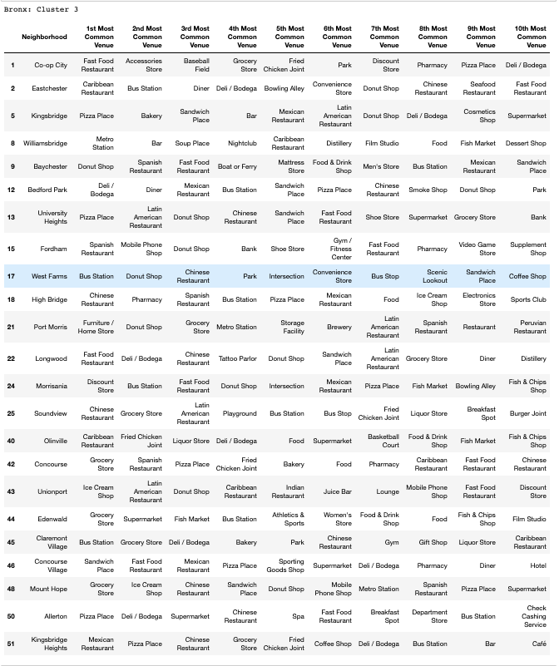
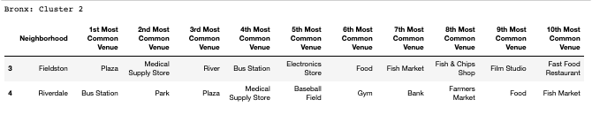
Data Analysis: KMEans Clustering
Bronx – Cluster 2 & 3

Slide 14
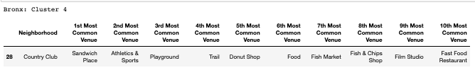
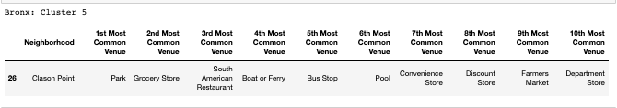
Data Analysis: KMEans Clustering
Bronx – Cluster 4 & 5

Slide 15
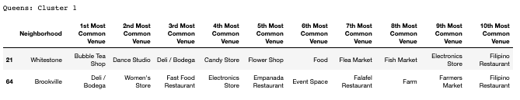
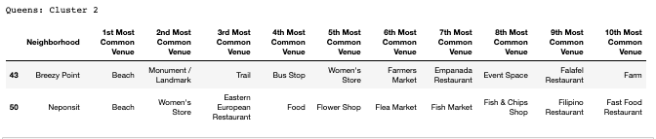
Data Analysis: KMEans Clustering
Queens – Cluster 1 & 2

Slide 16
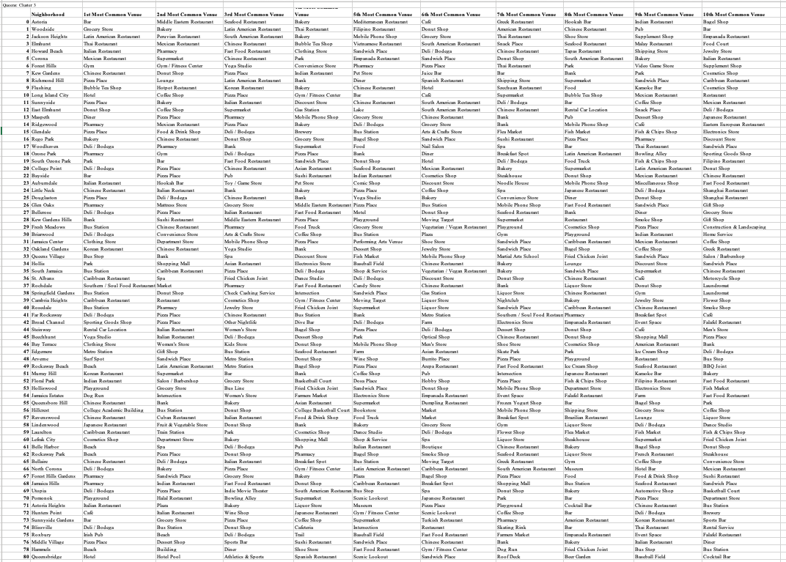
Data Analysis: KMEans Clustering
Queens – Cluster 3

Slide 17
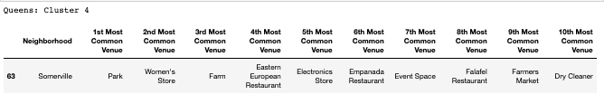
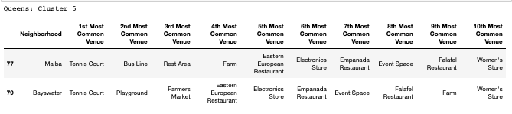
Data Analysis: KMEans Clustering
Queens – Cluster 4 & 5

Slide 18
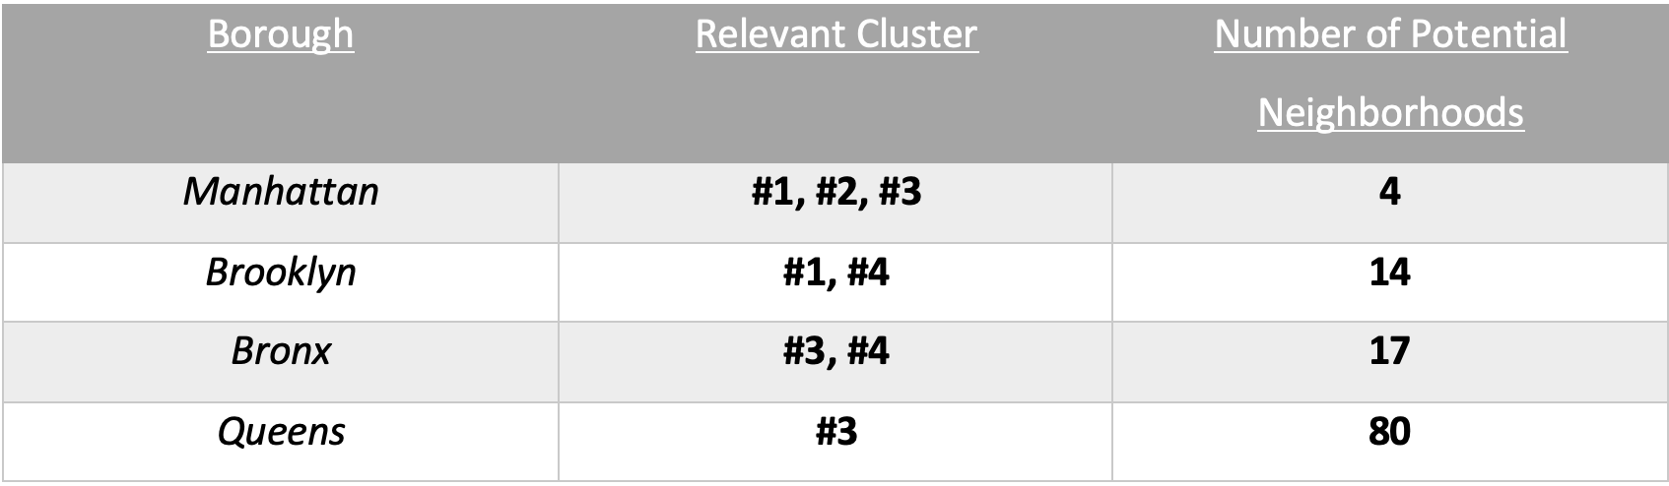
Results

Slide 19
Discussion
An important observation that can be made from the KMeans analysis is that as the number of relevant clusters for each borough increases, so does the number of potential of neighborhoods. This observation speaks to the effectiveness of the KMeans analysis, in categorizing and organizing the data into clusters.

Slide 20
Conclusion
In order to determine the optimal location for a new coffee shop in New York City, a New York City dataset was created, which leveraged Foursquare API to compile data about the business composition of the boroughs of Manhattan, Brooklyn, Bronx, and Queens. Using KMeans clustering analysis, each of the neighborhoods in these 4 boroughs was organized into clusters which could identify the neighborhoods in which there was a potential market for a coffee shop, and where there was limited competition. The KMeans clustering analysis clearly showed that the Queens borough had the largest market and limited competition, with 80 potential neighborhoods to choose from.

